Slide 1
Vidyasetu-Bridging to success
2410030272-NUPUR MADHREY
2410030079-AVIKA KASHYAP
2410030044-T.NIHARIKA
Under the Guidance of
Mr. .Chiranjeevi
Computer Science and Engineering Department
KL Hyderabad Off Campus, Aziz Nagar ,Hyderabad

Slide 2
Overview
Introduction
Objectives of the Project
Proposed Methodology/Architecture/Algorithm/Technique/etc
Implementation Details
Results (If any one objective is completed)
References

Slide 3
Introduction
Currently, students preparing for government exams face scattered information across multiple platforms, making preparation confusing and time-consuming.
Vidyasetu provides a unified digital space where exam dates, notifications, and registration links are easily accessible.
It offers personalized timetables, helping students organize their preparation effectively.
Integrated countdowns and reminders keep learners on track without missing key deadlines.
Study resources like books, practice papers, and video materials are made available in one place.
By bridging scattered information into a single structured hub, Vidyasetu simplifies exam readiness for every student.

Slide 4
Objectives of the Project
Bring all exam dates and updates together in one place so students don’t have to search everywhere.
Help learners manage their time better with an easy, personalized timetable.
Make study resources and guidance accessible without unnecessary hurdles.
Keep students prepared and confident with timely reminders and alerts

Slide 5
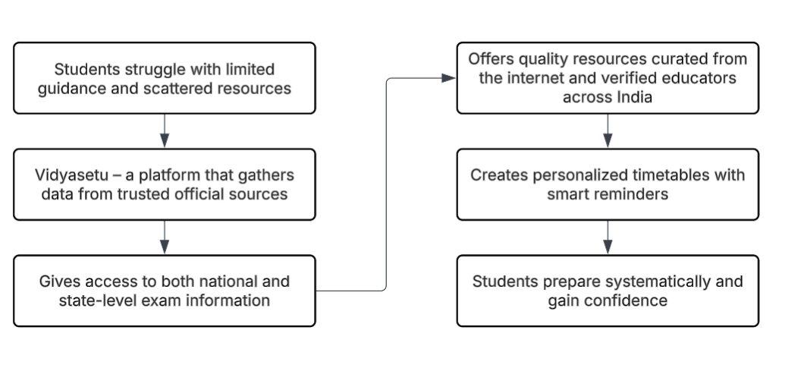
Proposed Methodology/Architecture/Algorithm/Technique/etc

Slide 6
Implementation Details
Frontend designed with HTML, CSS, JavaScript for clean UI/UX.
Followed a modular design model, dividing the site into sections: About, All Courses, My Timetable, Login.
Used flow-based navigation model to guide students from exam information → resources → personalized timetable.
Code Editor: Visual Studio Code.
Design Tools: Lucid chart for flow diagrams
Backend and design:

Slide 7
References:
“
E-learning Platforms: A Study on Online Education Systems" – International Journal of Emerging Technologies in Learning (iJET), 2020.
https://www.swayam.gov.in/ – Government of India’s e-learning platform (official comparison).
SarkariPariksha – https://sarkaripariksha.com/ — Specialises in notifications, exam dates, state & central level competitive exams.

Slide 8
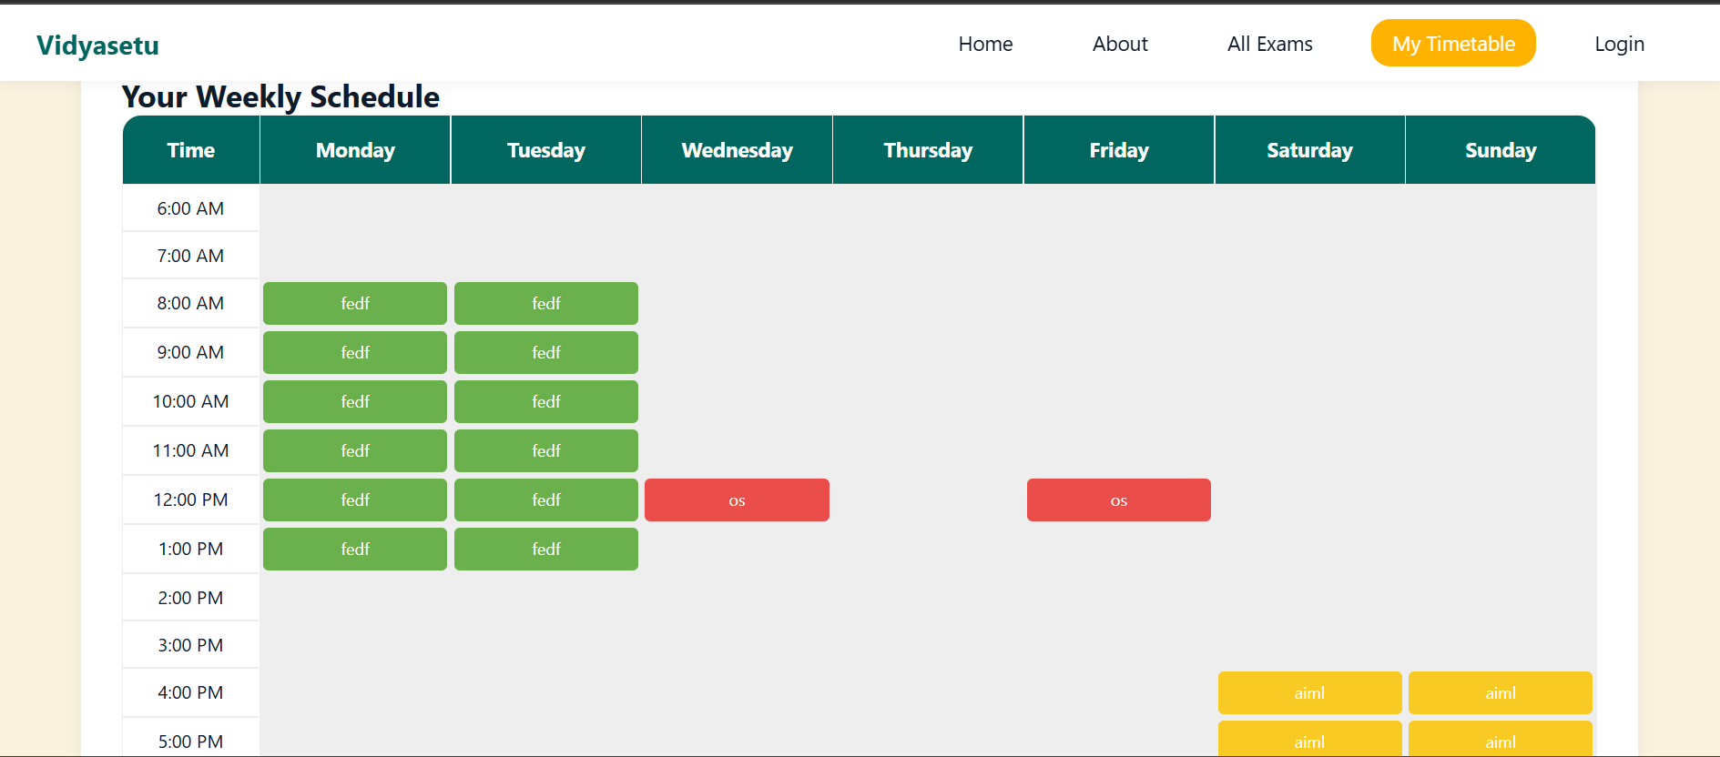
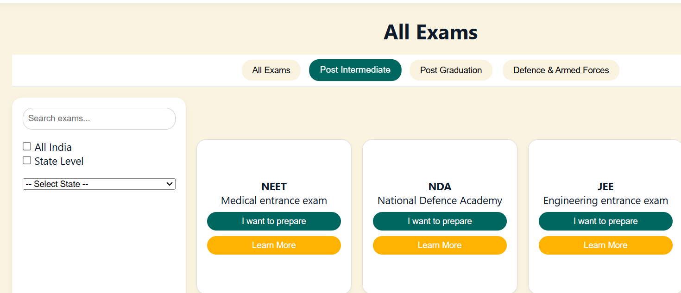
Results

Slide 9
Thank you and Any Queries

